Slide 1
Transforming CS Energy’s Business, People, and the Energy Market
Laura Burge, Mastering SAP Conference

Slide 2
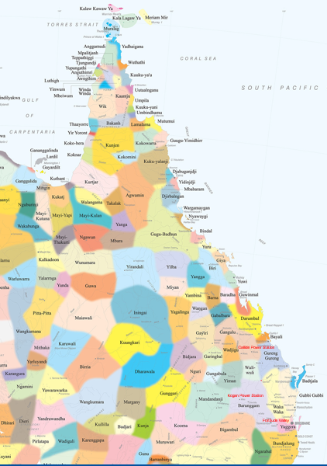
Acknowledgement of Country
CS Energy acknowledges the Traditional Owners of the lands on which we operate.
We live, work and learn on Turrbal, Jagera (Brisbane), Barunggam (Kogan Creek) and Gangalu (Biloela) land.
We pay our respects to their elders past and present, and recognise their continuing connection to the land, waters and community.

Slide 3

My SuccessFactors Journey
HR Consultant London
Future Pathway Manager
Brisbane
Talent Manager
Brisbane
AVP in Organisational Development Chicago
HR Analyst Melbourne
HR Manager Melbourne

Slide 4
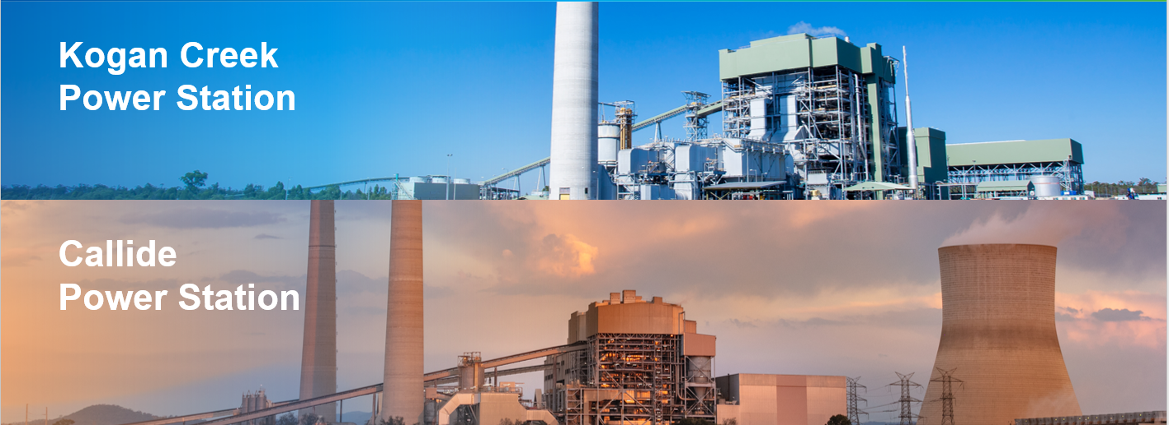
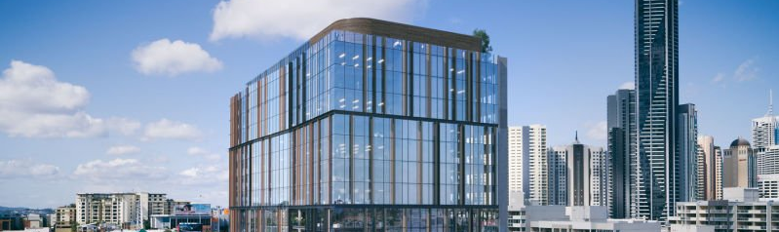
Callide
Power Station
Brisbane Head Office

Slide 5
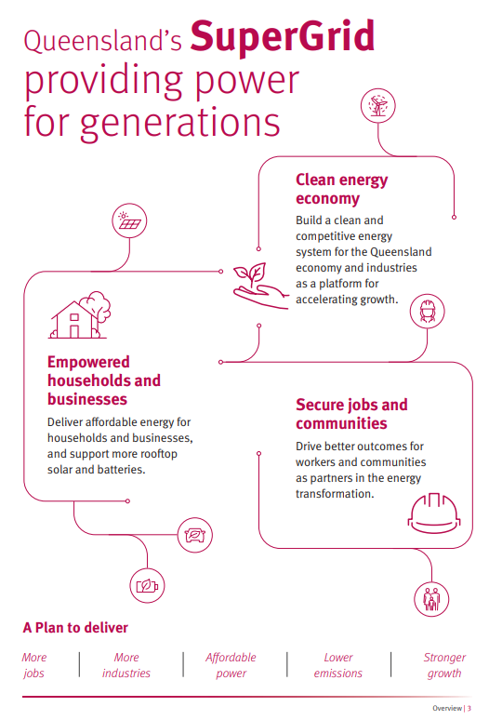
Queensland Energy and Jobs Plan
Powering towards 70% renewable energy by 2032 and
80% by 2035

Slide 6
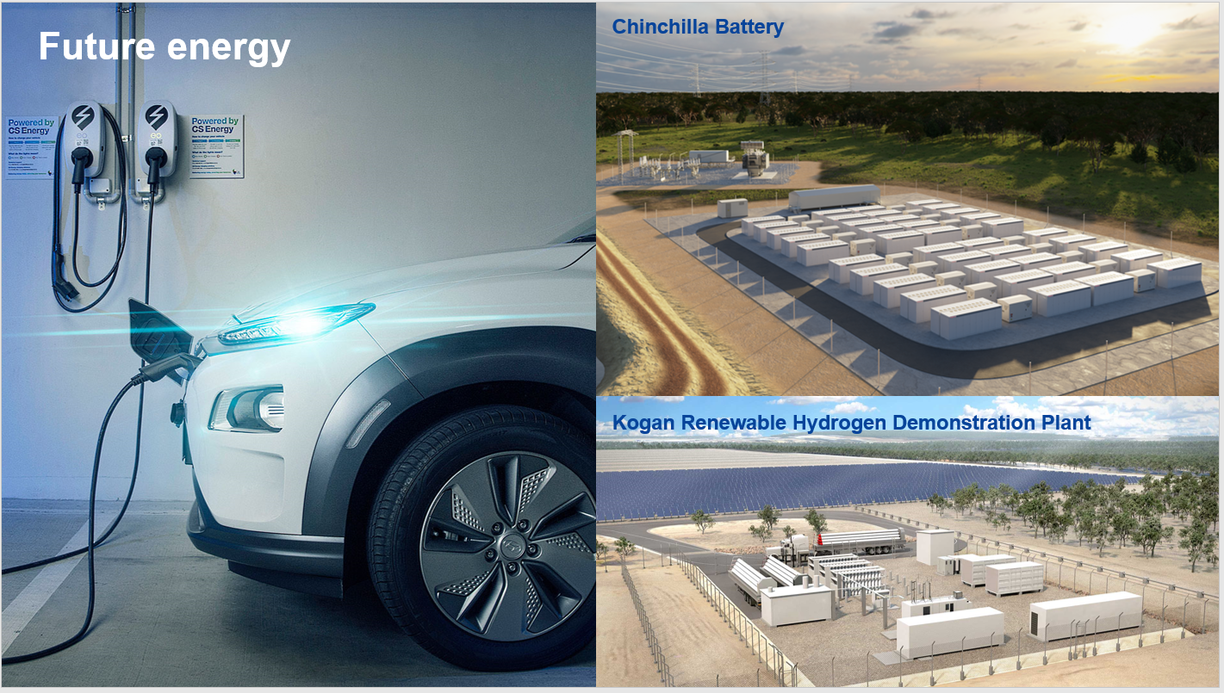

Slide 7
Our SuccessFactors Platform
Learning
Employee Central
Recruitment & Onboarding
Performance & Goals
Succession
Compensation &
Variable Pay
Pre-Project
2015
Release One
2019
Release Two
2020
Release Three
2021

Slide 8
Why Strategic Workforce Plan?
Workforce planning is a process of analysing the current workforce, determining future workforce needs, identifying the gap between the workforce you will have available and your future needs, and implementing solutions so that an organisation can accomplish its mission, goals, and strategic plan.
Workforce planning is taking the steps today to ensure we have:
The right people
In the right place
With the right skills
At the right time
At the right price

Slide 9
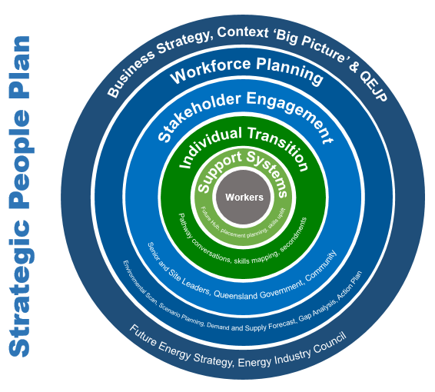
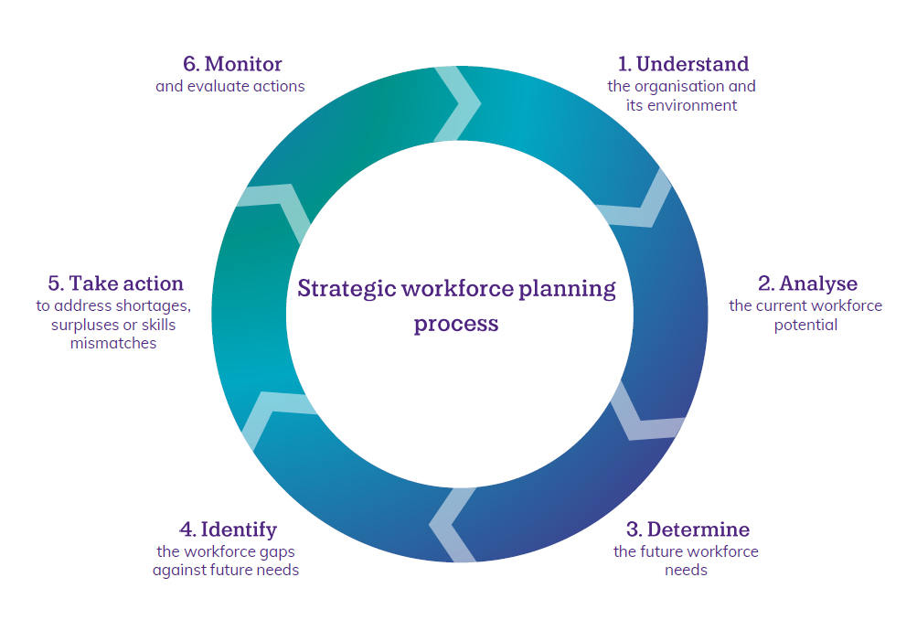
Workforce Planning Process

Slide 10



Step 1 Understand: Environmental Scan
8
4
5
3.8%
2
1
For every two people who enter the workforce, one leaves
Unemployment Rate, with…..
187,000
Headcount
243
people in QLD looking for work
Every month….
80,000
Callide
Large gaps in certifications and qualifications despite the
106
baby boomers exit the workforce
134%
280,000
Kogan
199
Increase in apprentices
proposed new jobs in QLD
Brisbane

Slide 11
Step 2 Analyse: Data at our Fingertips
Learning
Development
Performance
Demographic
Talent
Succession
Remuneration
Recruitment
Onboarding
Engagement

Slide 12


Leveraging what we have and what we know
Talent Cycle | Employee Central | Performance | Succession & Talent | Learning | Recruitment
Critical roles Knowledge risk individuals | Career transition, job and employment profiles Previous experience Skills and qualifications | High performers High performing teams Leaders who produce talent | High risk roles Succession pipeline Leader bench strength Nomination and readiness profiles | Licences Skills Qualifications | Time to fill Time to start Hard to recruit roles

Slide 13
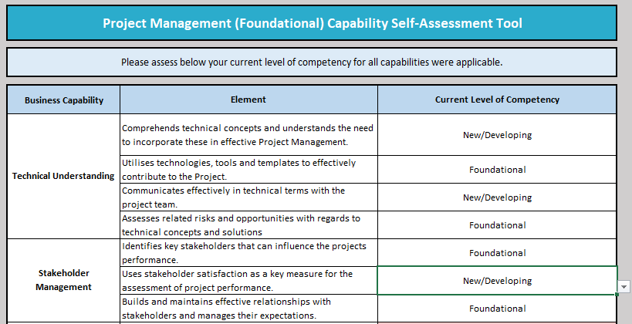
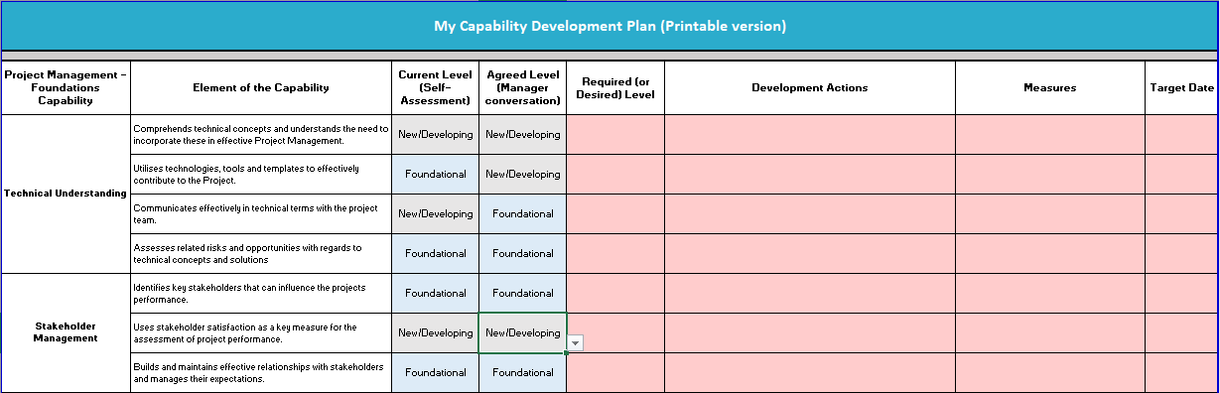
Step 3 and 4 Determine:
Skills and Capability Assessments

Slide 14
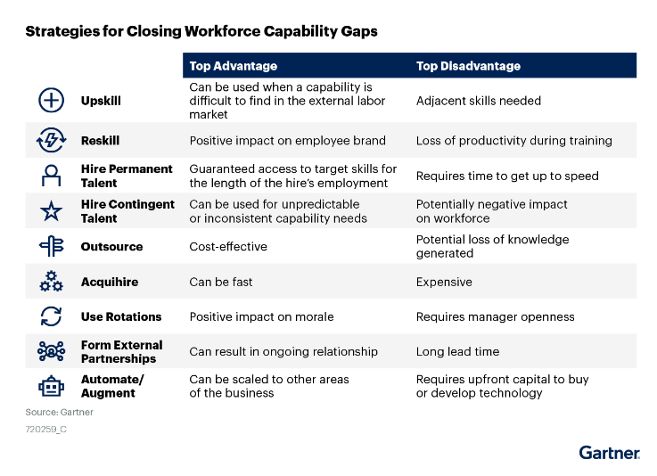
Step 5 Take Action: Closing Capability Gaps

Slide 15
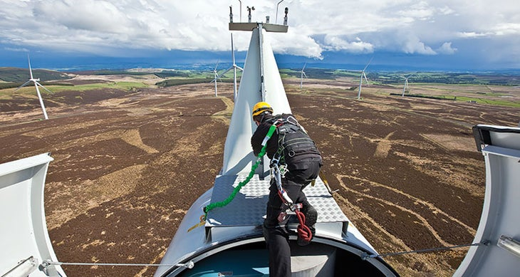
Workforce Planning In Action
Asset Operations and Maintenance Technicians
Critical Role: Wind Turbines
A grade electrician and or mechanical fitter
Working at heights permit
Working in confined spaces
Wind turbine skills / training certification
3 - 4 year lead time

Slide 16
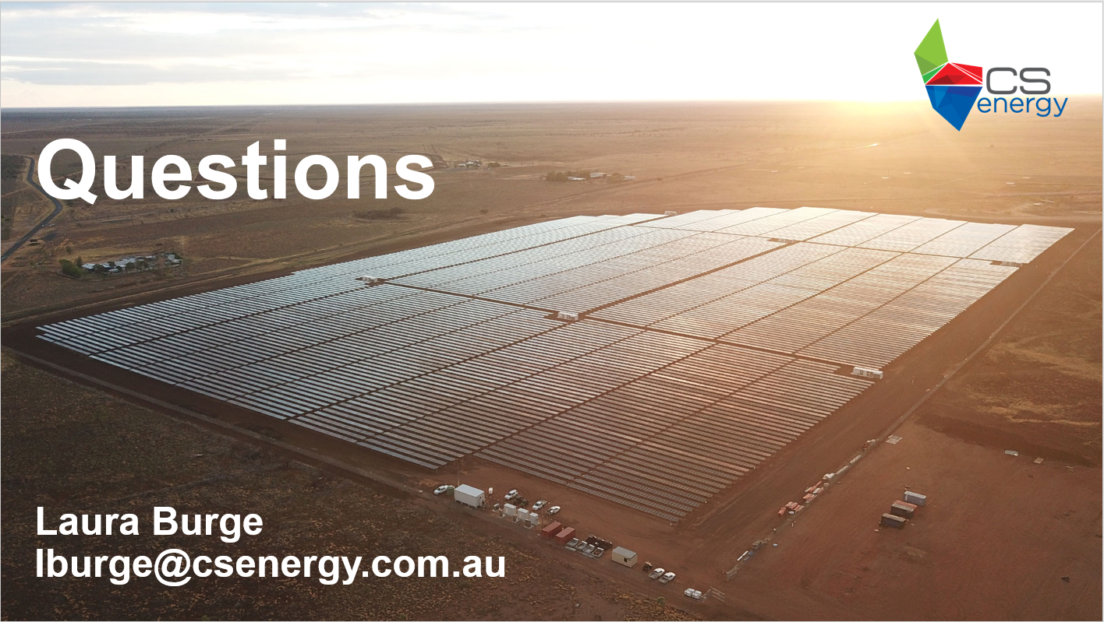

Questions

