Slide 1
Supply Chain Trends:
Top Challenges and Actionable Insights for Leaders
December 6, 2022
THE MOST TRUSTED INDEPENDENT
INFORMATION SOURCE FOR SAP
ENTERPRISE SOFTWARE CONTENT
SAPINSIDER COMMUNITY
600,000+ STRONG

Slide 2

Thank You to Our Executive Forum Partner

Slide 3
Agenda
SAPinsider Research Insights
Fireside Chat with Deloitte Experts
Open Q & A

Slide 4
Welcome and Research Overview

Slide 5
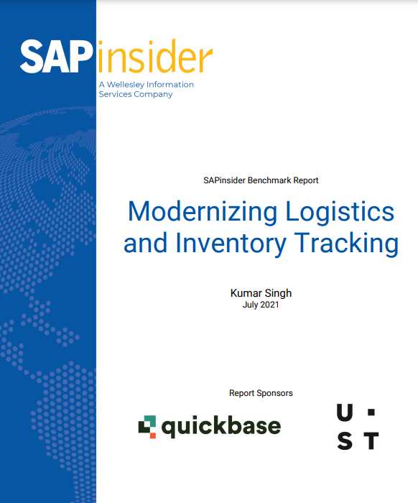

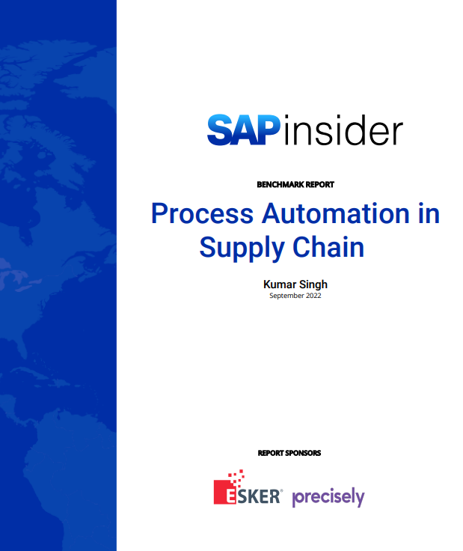
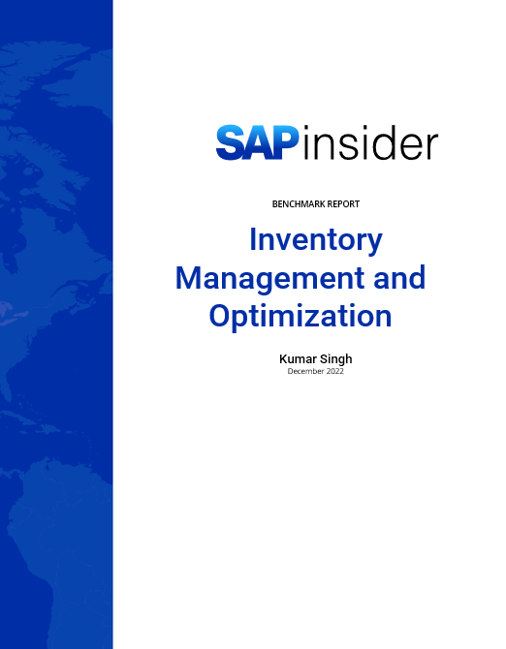

SAPinsider Research Key Highlights
SAPinsiders continues delving into what is on top of mind of key decision makers as well as end-users when it comes to leveraging technology in supply chain domain, through extensive research.
Modernizing Logistics & Inventory Tracking
July 2021
Supply Chain Planning in The Cloud
July 2022
Process Automation in Supply Chain
September 2022
Inventory Management & Optimization
December 2022

Slide 6
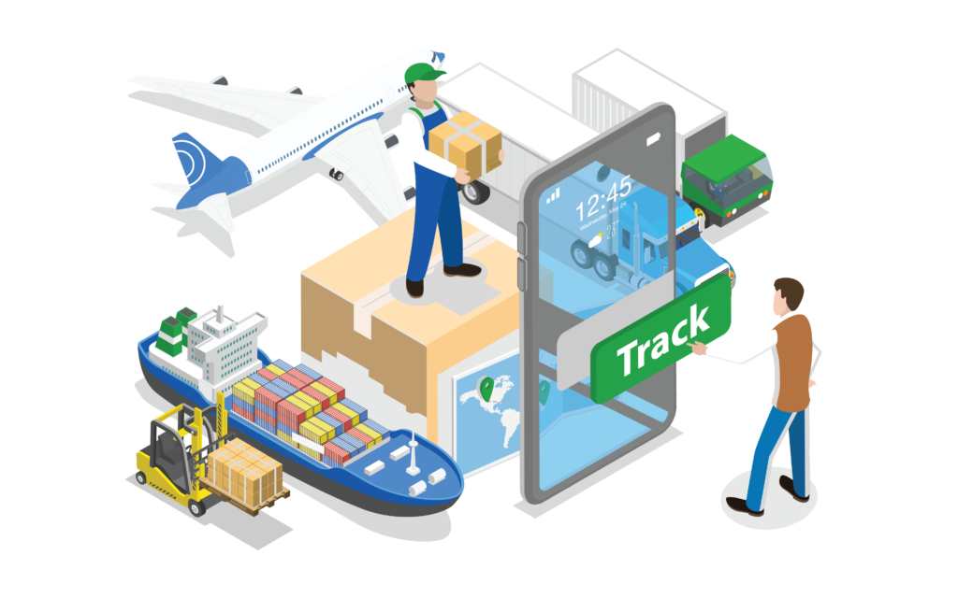
Resiliency and Agility are Top Business Drivers
Supply chain resiliency and agility have consistently emerged as top business drivers that SAPinsiders are looking to address. There are certain key aspects that they are focusing on when it comes to building supply chain agility and resiliency:
Building end-to-end supply chain visibility
Minimizing information latency across the supply chain network
Increasing collaboration internally as well as enhance partner integration
Flexible manufacturing and logistics capabilities to address supply chain volatilities
Managing a wide gamut of supply chain risks effectively
Balancing responsiveness and efficiency

Slide 7

Customer is The King
Evolving customer expectations and demands add to supply chain complexities and hence, also impact supply chain challenges that SAPinsiders need to address, like:
Increasing demand of features and functionalities is increasing complexity of SKU portfolio
Consumers are replacing products faster, thereby reducing product life cycle
They want the products faster (Requiring logistics flexibility and increasing complexity of service level offerings)
They want to order products as per their convenience (Omnichannel)
Customers want companies to actively participate in helping preserve the environment, be socially responsible and ethical

Slide 8

Serve with Care
SAPinsiders want to run the best-of-the breed supply chains but in a way that minimizes impact on environment, helps preserve our ecosystem, reduces waste and complies with all local and international regulations. Hence, the key aspects they are focused on in this area are:
Supply chain transparency
Circular supply chains
Optimizing reverse logistics
Sustainable procurement
Sustainable manufacturing
Carbon footprint minimization and reporting

Slide 9
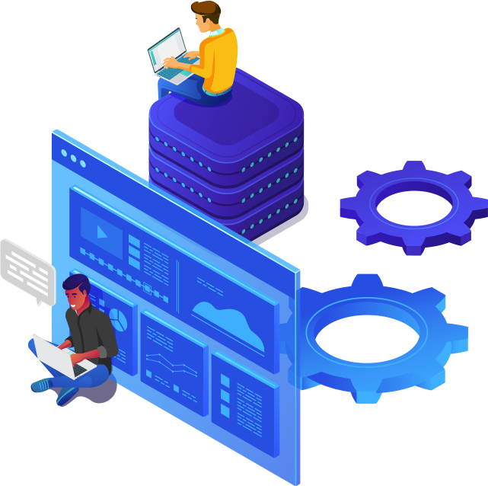
Innovate with People
Supply chain uncertainties and volatility, combined with aspects like evolving customer demand and rapidly lowering barriers to entry means that organizations need to innovate not only in their products and services but also in the way they run their enterprise. And people are at the core of innovative organizations. Hence, SAPinsiders are focused on:
Reskilling existing employees
Embracing self-service technology tools
Defining a talent strategy for supply chain organization
Leveraging technology to rapidly experiment with new technologies
Building in-house innovation hubs

Slide 10

How are SAPinsiders Planning to Address Challenges?
To address the challenges SAPinsiders are facing, there are certain capability areas that they are focused on:
Data centralization
Data harmonization and governance
Near real-time data collection and processing
Data integration
Actionable insights through evolved business intelligence
Integrated business planning
Advanced analytics-based supply chain planning leveraging AI and ML
Low-Code, No-Code Applications
Supply chain control towers
Process automation and intelligence
Smart supply chains leveraging cognitive automation and IoT
Leveraging emerging technologies

Slide 11
Fireside Chat

Slide 12


Chip Kleinheksel
Deloitte Global SAP Chief Technology Officer
Vadhi Narasimhamurti
Deloitte Global Supply Chain Leader

Slide 13
Open Q&A

